Slide 1
TOPT APPLICATION ATTACHMENTS
How to access the PDF attachments

Slide 2
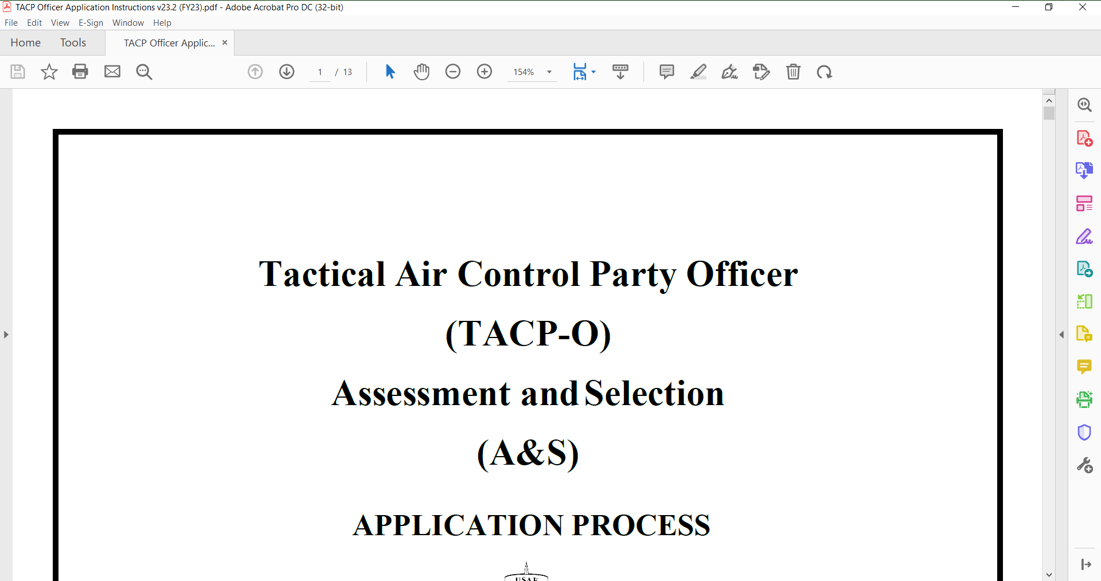
WHEN YOU OPEN THE APPLICATION, YOU SHOULD SEE THIS SCREEN IN ADOBE
CLICK HERE TO OPEN THE ATTACHMENT TOOLBAR

Slide 3
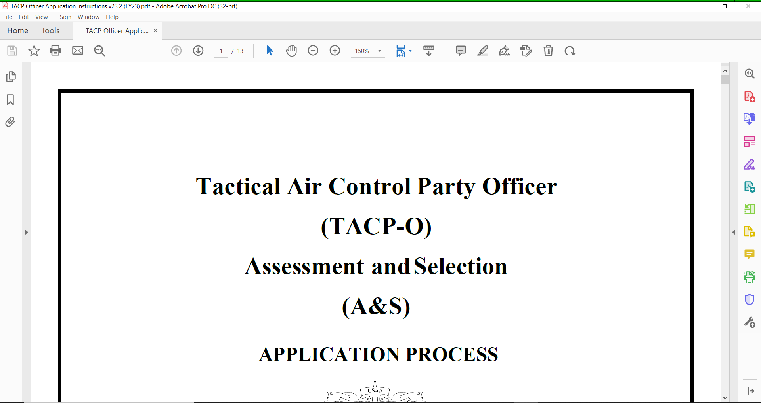
CLICK HERE TO VIEW THE ATTACHMENTS

Slide 4
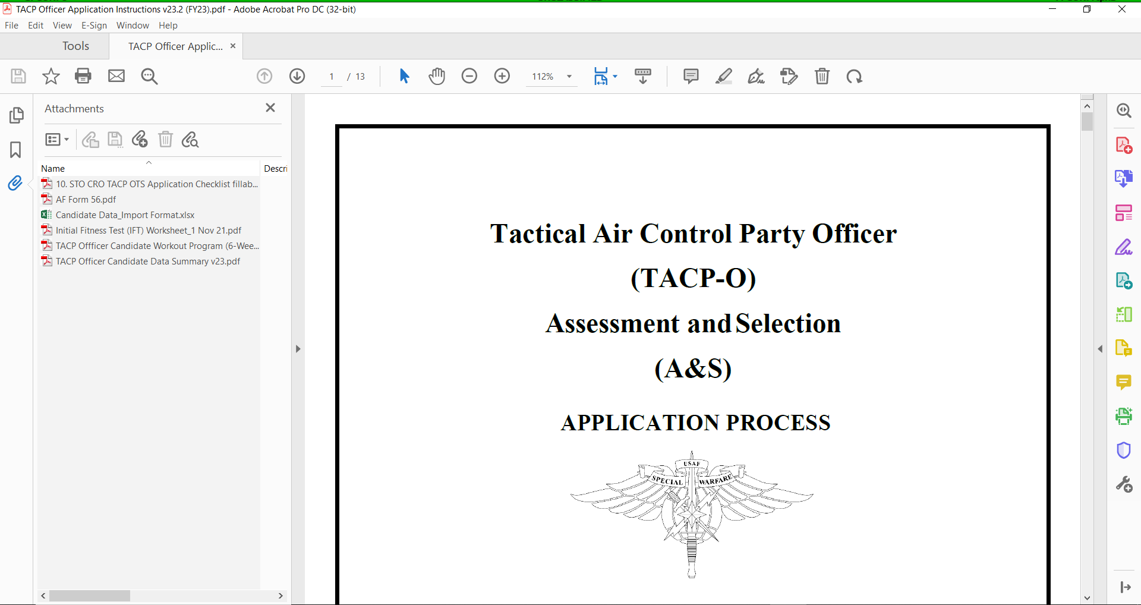
DOUBLE-CLICK TO VIEW EACH ATTACHMENT

